Slide 1
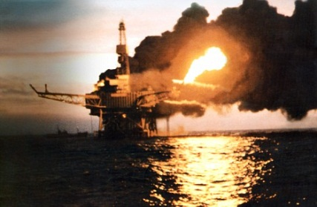
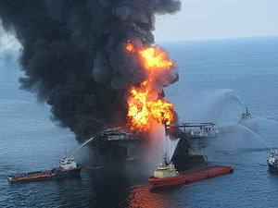
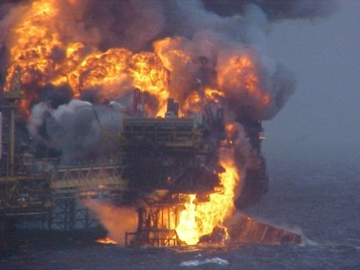
PROPOSAL – JOINT INDUSTRY PROJECT (JIP) FLACS-Fire

Slide 2
Motivation
Accidental fires represent a significant hazard to people, property and the environment
Experimental investigations of large-scale fire phenomena are inherently expensive
The aim is to accelerate the development of the CFD tool FLACS into a state-of-the-art tool for fire simulations

Slide 3
FLACS - history
The FLACS software has been developed by GexCon for 30 years to become a leading CFD consequence tool for explosion and dispersion
GexCon is an internationally renowned company in the field of gas dispersion and explosion safety
FLACS is well-validated for explosion simulations and is widely accepted by authorities worldwide

Slide 4
FLACS – history cont.
Use of FLACS for explosion safety analyses offshore is recommended as a part of the NORSOK standard in Norway
FLACS has also been officially accepted by the US Department of Transportation as the first CFD consequence tool to be used for dispersion studies in connection to LNG facility siting according the NFPA-59A standard

Slide 5
Benefits of using FLACS
FLACS is user-friendly and efficient compared to most other CFD-tools
FLACS has been extensively validated for explosion and dispersion studies in petrochemical facilities, and the same emphasize on validation will be employed for FLACS-Fire
Existing FLACS users will be able to use the same geometry models for dispersion, explosion and fire simulations

Slide 6
Benefits of using FLACS, cont.
Existing FLACS users will get a significant discount on the fire simulator
There will be limited need for additional training for experienced FLACS users

Slide 7
FLACS-Fire modeling capabilities
Jet and pool fires in petrochemical process plants, under varying atmospheric conditions
Confined or unconfined fires in congested geometries
Radiative and convective heat transfer to solid objects
Distribution of smoke and toxic products

Slide 8
Expected sponsorship level
JIP sponsors for the FLACS-Fire must commit to minimum 1 year (400 000 NOK)
The total amount per participant will hence be 1.6 million NOK for the full period (4 years)
Tentative JIP start-up in December 2012/January 2013

Slide 9
Benefits of being a sponsor
Be a part of an international expert group on fire safety
Position your organization as a global leader in the field of fire safety and contribute to research and knowledge-building
Get the opportunity to take part in and influence the development process
Gain access to beta-releases as well as final commercial releases of FLACS-Fire
The right to prioritize 3 man-months R&D work in the voting process when prioritizing work for the next budget period.
Free access to company internal license level test versions of FLACS-Fire (+Dispersion) during the sponsorship period.
25% of the sponsorship funding can be deducted against future purchase of FLACS-Fire (and other FLACS-SW payments if excess deductions).
Simulation setups for tests in main validation matrix during support period

Slide 10
Interested?
More details can be found in the full project proposal on the FLACS-Fire JIP
More questions? Contact information can be found in the proposal

